Slide 1
Data and Web Application CC6012
Blockchain with MongoDB
Dr Rattapol Kasemrat

Slide 2
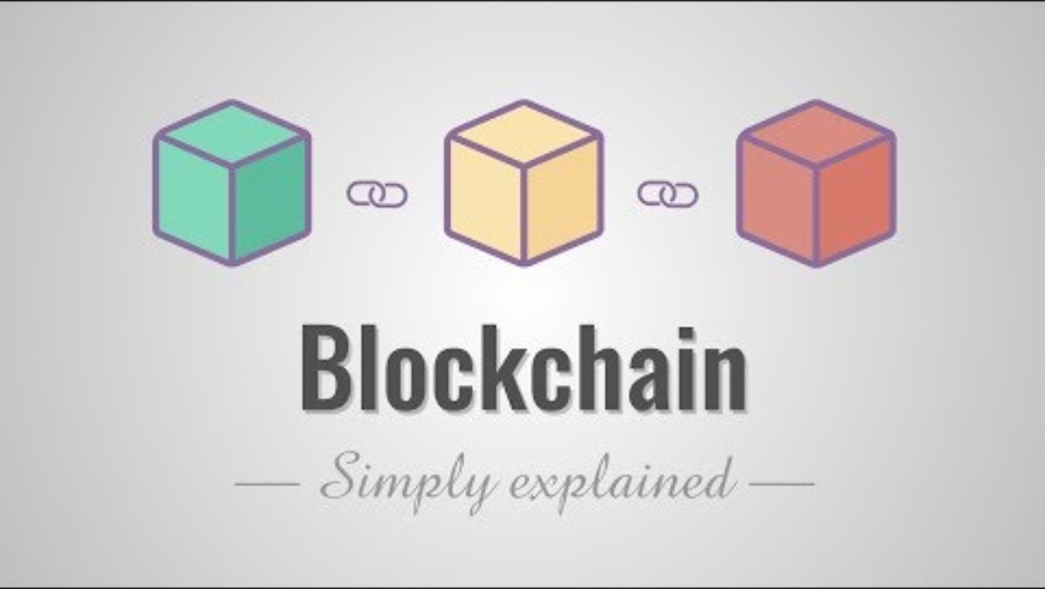

Slide 3
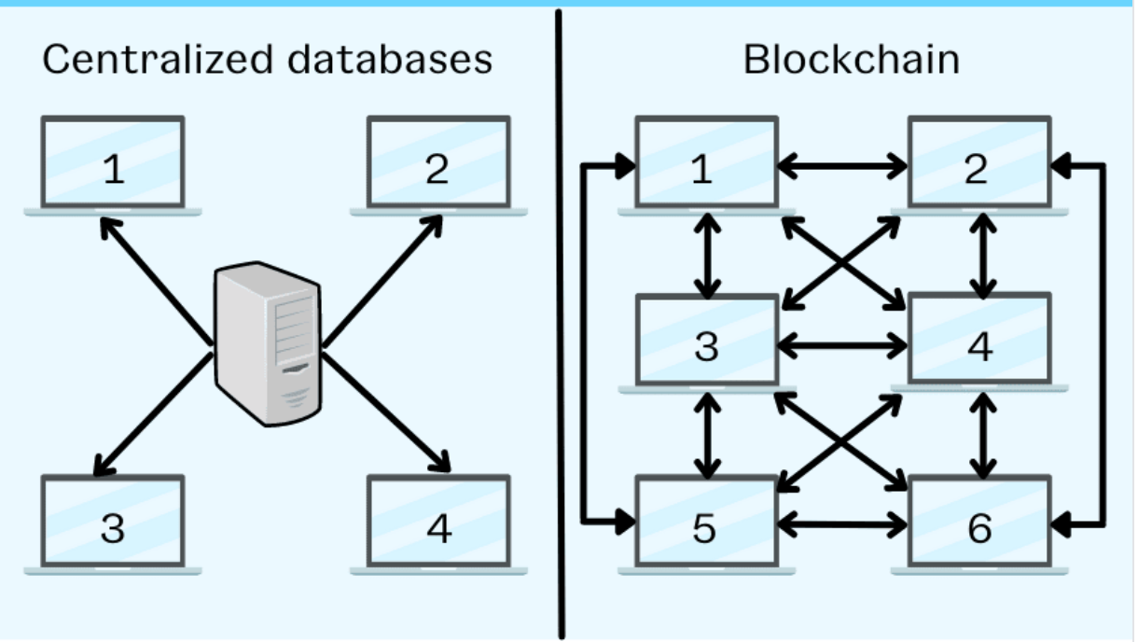
Content
Blockchain with MongoDB

Slide 4
What is Blockchain
Blockchain is a decentralized and distributed digital ledger technology that records transactions in a secure, transparent, and immutable way. It's the underlying technology behind cryptocurrencies like Bitcoin, but its applications extend beyond just digital currencies.
How does blockchain protect data?
Blockchain tech does not rely on trusted third parties to protect the data in a database. Instead, the blockchain uses the technology’s decentralized nature to protect the data.
In a standard database, a computer virus can infect the entire server because the information is stored in one area. A computer hacker can unleash a virus, worm, or another type of malware into the computer system to corrupt or delete data. If this happens, the information is lost. Or, you could spend a lot of time trying to recover the data.

Slide 5
How does blockchain protect data?
All too often, a centralized server is the only copy of the data. In that case, losing the data due to malicious software can lead to disaster.
With a blockchain, the data is spread out over multiple sources. A change in one copy does not change the other copies. And, the algorithm can quickly locate the change to one copy.
So, if a hacker tries to use a virus to destroy data in one blockchain, the information is not lost. And if someone alters the information in one block of the chain, then the original data does not change with it, so the algorithm can quickly locate where the change occurred.
The process of creating copies has an added benefit. There is an established timeline and order of events in the blockchain. So, users can identify when the change took place, too.

Slide 6
Core Concepts
Decentralization: Unlike traditional centralized systems where a single entity has control, blockchain operates in a decentralized manner. Multiple participants (nodes) in the network validate and agree on the state of the ledger.
Blocks and Transactions: A blockchain consists of a chain of blocks. Each block contains a set of transactions that have been agreed upon by the network. Transactions could represent anything of value, not just financial transactions.
Consensus Mechanism: To ensure agreement on the state of the ledger, participants need to reach a consensus. This is typically achieved through various consensus mechanisms, like proof-of-work (used in Bitcoin) or proof-of-stake.
Security and Immutability: Once a block is added to the blockchain, it's very difficult to alter the information in it due to cryptographic hashes and linking to the previous block. This immutability provides security and trust in the system.
Transparency: All participants in the network can access the entire history of transactions, which promotes transparency and accountability.

Slide 7
Bitcoin utilizes cryptographic hash functions, particularly SHA-256, to secure transactions and ensure the integrity of the blockchain, forming the basis of its Proof-of-Work mechanism and immutability.
What are Cryptographic Hash Functions?
Cryptographic hash functions are mathematical algorithms that take an input (data of any size) and produce a fixed-size output (a hash value or "fingerprint").
They are designed to be one-way, meaning it's computationally infeasible to reverse the process and find the original input from the hash.
Even a tiny change in the input results in a drastically different hash output, ensuring data integrity.

Slide 8


Slide 9
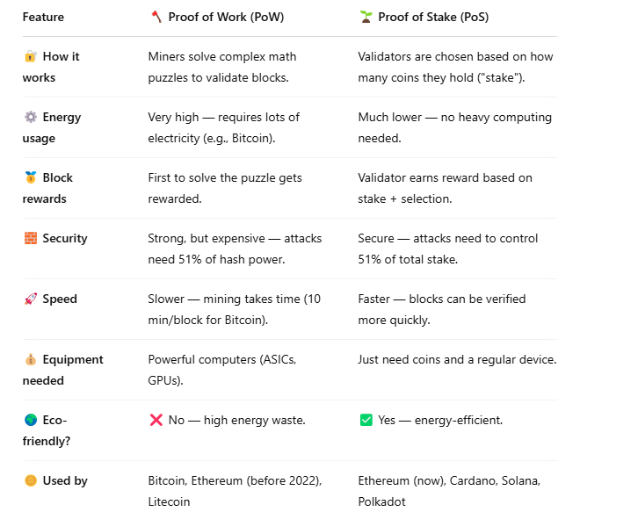
Proof of Work and Proof of Stake

Slide 10
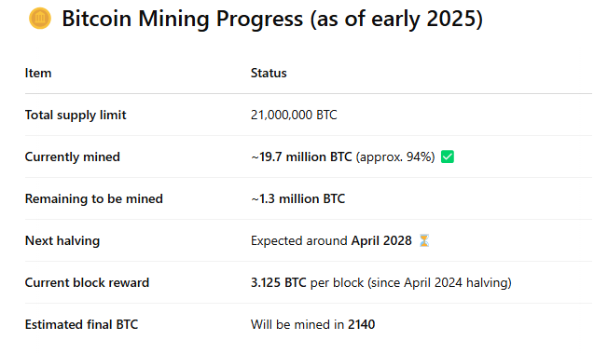
Bitcoin
Only 6% of Bitcoin remains to be mined — but it will take another 115 years due to the halving mechanism!

Slide 11
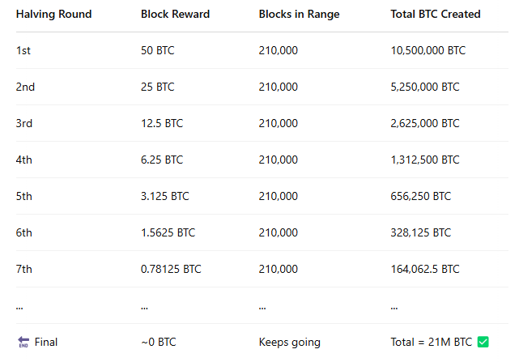
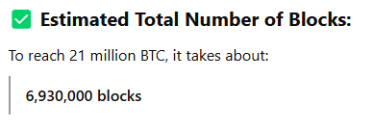
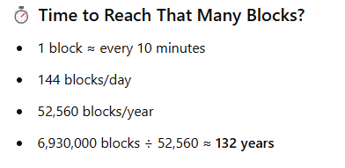
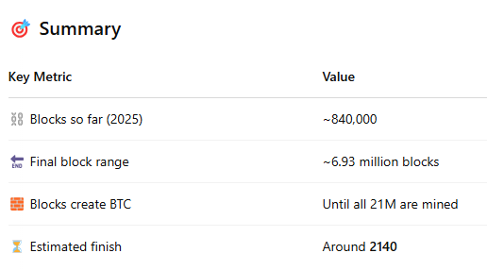
Bitcoin
https://www.blockchain.com/explorer

Slide 12
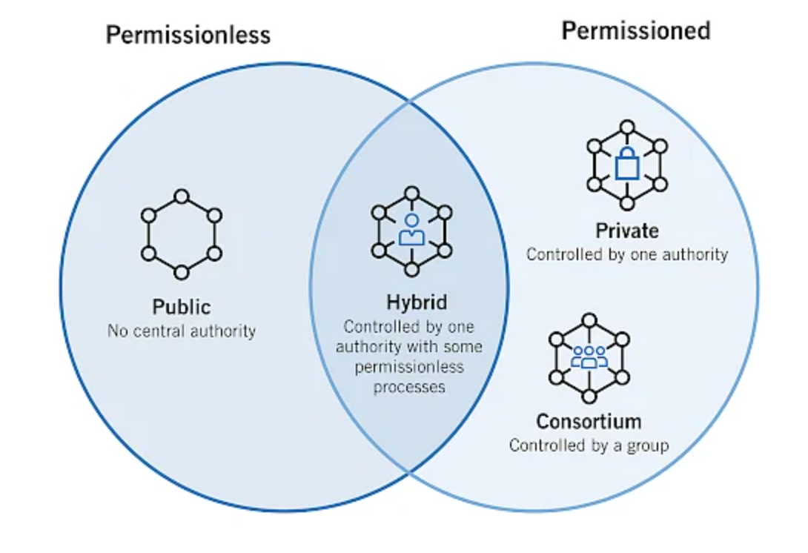
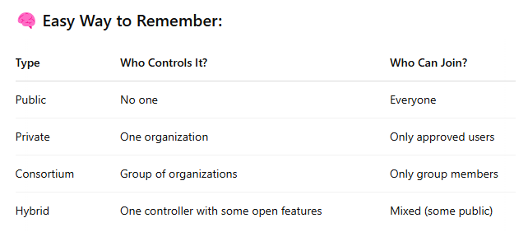
Types of Blockchain
Public Blockchain. It is a permissionless distributed ledger on which anybody can join and conduct transactions. ...
Private Blockchain. A blockchain network operates in a private context, such as a restricted network, or is controlled by a single identity. ...
Hybrid Blockchain. ...
Consortium Blockchain.

Slide 13
Common uses of blockchain
Blockchain is not a new concept in the digital landscape. But, it is becoming increasingly popular due to its multiple uses. As an example, Bitcoin, a form of cryptocurrency, began using blockchain in 2009 to protect the financial transactions of users.
Now, other digital industries use blockchain, including:
Cryptocurrencies
Smart contracts (i.e., buyer-seller agreements written into lines of software code)
Decentralized finance (DeFi) applications
Non-fungible tokens (NFTs), also known as crypto assets
If you use cryptocurrency or accept cryptocurrency as a form of payment in your business, your data from the exchange is stored in a blockchain.
https://opensea.io/collection/afe-nft

Slide 14
Blockchain and business
So if blockchain is typically used for activities such as cryptocurrency payment or transactions, how can you apply its use in your business? Most blockchain networks are public (e.g., Bitcoin). But,
your business can create a private blockchain network run behind your corporate firewall.
You also can create a permissioned blockchain network to restrict who has access to and can participate in the network.
By using your own blockchain network, you can encrypt customer information beyond standard database storage for added security.
Keep in mind that blockchain can be an expensive system to maintain and monitor. But if your business requires the use of personal identifiable information, it may be an expense to consider.

Slide 15
Using MongoDB as a Comparison with Blockchain
Data Structure:
In MongoDB, data is stored in collections of documents (JSON-like format).
In blockchain, data is stored in blocks, each containing a set of transactions.
Decentralization:
MongoDB can be used in a distributed manner, with data replicated across multiple nodes.
Similarly, blockchain operates in a decentralized network, where each node has a copy of the entire blockchain.
Immutability:
MongoDB data can be updated, replaced, or deleted, although historical versions can be retained.
In blockchain, once a block is added, it's practically impossible to alter its content due to cryptographic hashing.
Transactions:
MongoDB transactions involve updating documents within collections.
In blockchain, transactions represent changes to the ledger, and these changes are grouped into blocks.
Consensus:
MongoDB doesn't inherently require consensus among nodes for data changes.
Blockchain relies on consensus mechanisms to ensure agreement on the state of the ledger.
Security and Auditing:
MongoDB provides security mechanisms to control access to data.
Blockchain ensures security through cryptographic techniques and the distributed nature of the ledger.

Slide 16
Using MongoDB as a Comparison with Blockchain
In summary, while MongoDB is a database technology that allows efficient storage and retrieval of data, blockchain is a distributed ledger technology that offers decentralization, security, transparency, and immutability. Both technologies have their own use cases and advantages, but blockchain's unique properties make it particularly suitable for scenarios where trust, transparency, and tamper-proof records are essential, such as financial transactions, supply chain management, voting systems, and more.

Slide 17
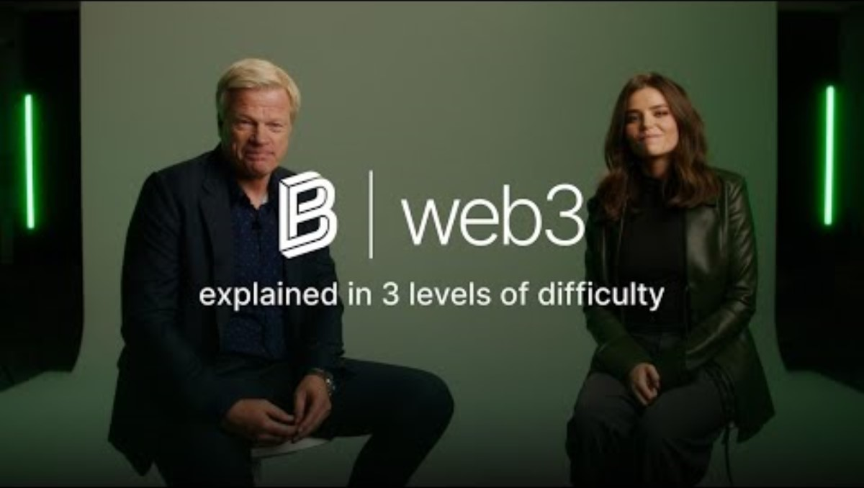

Slide 18
Let’s do exercise
Follow steps on GitHub
Homework (next page)

Slide 19
Tutorial Activity (Homework)
Add more block to the chain
Implement a new C# programme where the block data is saving as a MongoDB Document instead of a string (codes is provided)
Compare the difference between the data stored in the previous version and the 2nd version of the Blockchain programme
4. Complete the tutorial demonstrated in the class.
5. Complete tutorial questions for the week.

Slide 20
A simple tutorial to teach blockchain technology using MongoDB and C# VS 2022
Open Visual Studio 2022 and create a new C# Console Application project.
public class Block
{
public int Index { get; set; }
public string PreviousHash { get; set; }
public long Timestamp { get; set; }
public string Data { get; set; }
public string Hash { get; set; }
}
2 . Create a Block class to represent each block in the blockchain:

Slide 21
Block Class
creating the Block class, which is a fundamental building block of the blockchain. Each block in the blockchain contains information about transactions, a timestamp, its position in the chain, cryptographic hashes, and more. Let's break down the code and explain each part in detail.
Class Declaration: The code starts with the declaration of the Block class, which will define the structure of a single block in the blockchain.
Properties: Within the Block class, there are five properties that represent various attributes of a block:
Index: An integer value that represents the position of the block within the blockchain. The genesis block typically has an index of 0, and subsequent blocks have increasing indices.
PreviousHash: A string that stores the hash of the previous block. This creates a link between blocks and ensures their order and continuity.
Timestamp: A long integer representing the Unix timestamp of when the block was created. It helps establish the order of blocks in the blockchain.
Data: A string representing the data stored in the block. This could be transaction information, messages, or any other relevant data.
Hash: A string that holds the cryptographic hash value of the block's contents (including index, previous hash, timestamp, and data). This hash uniquely identifies the block and helps ensure its integrity.

Slide 22
A simple tutorial to teach blockchain technology using MongoDB and C# VS 2022
private Block CreateGenesisBlock()
{
return new Block
{
Index = 0,
PreviousHash = "0",
Timestamp = DateTimeOffset.Now.ToUnixTimeSeconds(),
Data = "Genesis Block",
Hash = CalculateHash("0")
};
}
private string CalculateHash(string input)
{
using (SHA256 sha256 = SHA256.Create())
{
byte[] inputBytes = Encoding.UTF8.GetBytes(input);
byte[] hashBytes = sha256.ComputeHash(inputBytes);
StringBuilder builder = new StringBuilder();
foreach (byte b in hashBytes)
{
builder.Append(b.ToString("x2"));
}
return builder.ToString();
}
}
public void AddBlock(string data)
{
Block previousBlock = chain[^1];
Block newBlock = new Block
{
Index = previousBlock.Index + 1,
PreviousHash = previousBlock.Hash,
Timestamp = DateTimeOffset.Now.ToUnixTimeSeconds(),
Data = data,
Hash = CalculateHash(previousBlock.Hash + data)
};
blocksCollection.InsertOne(newBlock);
chain.Add(newBlock);
}
public bool IsChainValid()
{
for (int i = 1; i < chain.Count; i++)
{
Block currentBlock = chain[i];
Block previousBlock = chain[i - 1];
if (currentBlock.Hash != CalculateHash(previousBlock.Hash + currentBlock.Data))
{
return false;
}
}
return true;
}
3. Create Blockchain Class to manage the blockchain:
First create a Genesis block
Calculate Hashes
Add Blocks
Verify Blocks
The full code is provided in the tutorial.

Slide 23
Blockchain class
Namespace and Class Declaration: The code starts with a namespace declaration and the definition of the Blockchain class. The using statements at the beginning import necessary namespaces, such as System, MongoDB.Bson, and MongoDB.Driver.
Private Fields and Properties: Inside the Blockchain class, there are private fields that store essential components:
chain: A list of Block objects that represent the entire blockchain.
blocksCollection: An instance of the MongoDB collection to store blocks.
Constructor - Initializing the Blockchain: The constructor method is responsible for initializing the blockchain. It does the following:
Initializes the chain list.
Creates a MongoDB client to connect to the local MongoDB server.
Retrieves the Blocks collection from the BlockchainDB database.
Creates the genesis block, which is the first block in the blockchain.
Inserts the genesis block into the MongoDB collection.
Adds the genesis block to the chain list.
Creating the Genesis Block: The CreateGenesisBlock method is responsible for creating the very first block in the blockchain, known as the genesis block. It initializes the block's properties such as index, previous hash, timestamp, data ("Genesis Block"), and hash. The hash is calculated using the CalculateHash method.
Calculating Hashes: The CalculateHash method calculates the SHA-256 hash of a given input string. It converts the input string into bytes, computes the hash bytes, and converts them to a hexadecimal string representation. This method is used to calculate hashes for blocks and verify the integrity of the blockchain.
Adding Blocks: The AddBlock method is responsible for creating a new block and adding it to both the blockchain's chain list and the MongoDB collection. It calculates the hash based on the previous block's hash and the new block's data. This method ensures that the blockchain remains secure and tamper-proof.
Verifying the Blockchain: The IsChainValid method iterates through the entire chain and checks if each block's hash matches the expected hash based on the previous block's hash and the block's data. If the hashes don't match, it indicates that the blockchain has been tampered with, and the method returns false. Otherwise, it returns true, indicating that the blockchain is valid and intact.

Slide 24
Use the Blockchain to insert data to MongoDB
class Program
{
static void Main(string[] args)
{
Blockchain blockchain = new Blockchain();
blockchain.AddBlock("Transaction Data 1");
blockchain.AddBlock("Transaction Data 2");
// Add more blocks as needed
bool isValid = blockchain.IsChainValid();
Console.WriteLine($"Is blockchain valid? {isValid}");
}
}
In your Program.cs file, create an instance of the Blockchain class and add blocks to the blockchain:

Slide 25
BlockChain instance class
Creating an Instance of the Blockchain: In the Main method of your Program class, you start by creating an instance of the Blockchain class. This instance will manage your blockchain and handle block addition and verification.
Adding Blocks to the Blockchain: After creating the blockchain instance, you can add blocks to it using the AddBlock method. This method takes a parameter, which is the data you want to include in the new block.This data can represent various types of transactions or information that you want to record in the blockchain.
Each time you call the AddBlock method, a new block is created, and it's linked to the previous block ian the chain.
The blockchain's integrity is maintained through cryptographic hashing and linking blocks together.
Checking Blockchain Validity: Once you've added blocks to the blockchain, you can check its validity using the IsChainValid method. This method iterates through the entire chain of blocks and verifies whether the hash of each block matches the calculated hash based on the previous block's hash and the block's data.If all blocks are properly linked and the hashes match, the blockchain is considered valid. If there's any tampering or inconsistency in the blockchain, the validity check will return false.

Slide 26
Reference
Recommended Reading:
https://www.mongodb.com/databases/blockchain-database#:~:text=MongoDB%3A%20The%20database%20that%20the,decentralized%20and%20immutable%20data%20storage.
https://aws.amazon.com/what-is/blockchain/?aws-products-all.sort-by=item.additionalFields.productNameLowercase&aws-products-all.sort-order=asc
https://www.simplilearn.com/tutorials/blockchain-tutorial/types-of-blockchain

Slide 27
Thank you for Listening…

